Slide 1


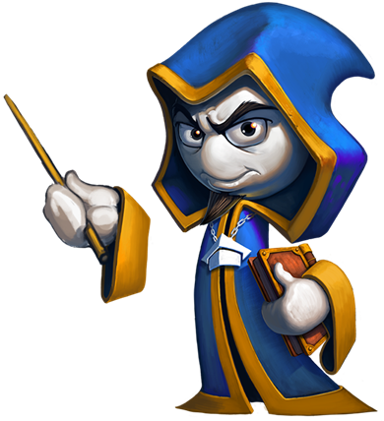

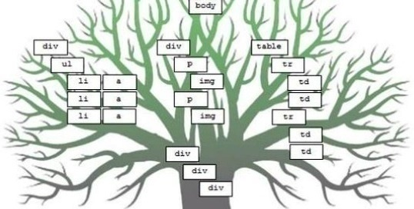
Events
Event Handling in JavaScript
Advanced
JavaScript
SoftUni Team
Technical Trainers
Software University
http://softuni.bg

Slide 2


Table of Contents
JavaScript Event Model
Event Handler Registration
The “event” object
Capturing and bubbling events
Event chaining

Slide 3

JavaScript Event Model

Slide 4
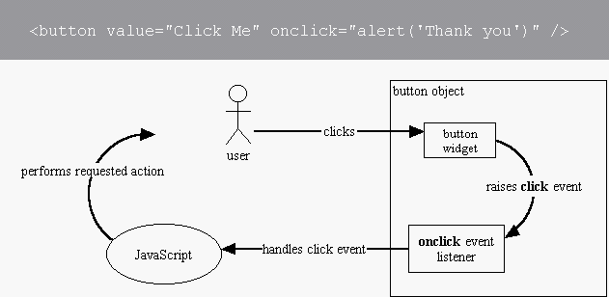
Event Model
The DOM event model provides notifications for certain events
E.g. execute a JS function when a button is clicked
The DOM event model consists of events and event listeners attached to the DOM objects
Events Demo

Slide 5
Event Types
DOM provides access to many events
Mouse events – mouse clicks, mouse moves, mouse over, …
Touch events – finger touch, touch start, end, move, …
Form events – field focus, value change, form submit, …
Keyboard events – key down, key up, key press, …
DOM / UI events – node insert, node remove, load, resize, …
Full list of all DOM event types:
http://www.w3.org/TR/DOM-Level-3-Events/#event-types-list
You may also define custom event types

Slide 6
Common Event Types
Mouse events
DOM / UI events
click
hover
mouseup
mousedown
mouseover
mouseout
load
abort
select
resize
change
Touch events
touchstart
touchend
touchcancel
touchleave
touchmove
Keyboard events
Focus events
keydown
keypress
keyup
focus
blur
focusin
focusout

Slide 7
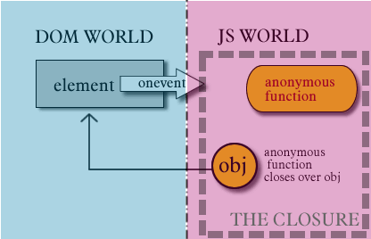
Event Handler Registration

Slide 8
Define Event Handler in the HTML Code
Event handling JavaScript code can be specified in the HTML attributes onclick, onload, onmouseover, onresize, …
<button onclick="buttonClickFunction()">Click Me!</button>
function buttonClickFunction() {
console.log("You clicked the [Click Me!] button");
}
<button onclick="alert('OK clicked')">OK</button>

Slide 9
Define Event Handler in the JS Code
Event handling JavaScript code can be specified in the JS code through the properties onclick, onresize, …
<button id="click-button">Click Me!</button>
<button id="click-button">Click me</button>
var button = document.getElementById("click-button");
button.onclick = function onButtonClick() {
console.log("You clicked the button");
}

Slide 10
Using addEventListener(…)
A more powerful way for attaching event handlers:
isCaptureEvent: catch the "capture" or "bubbling" phase
Can attach multiple events in a chain
domElement.addEventListener(
eventType, eventHandler, isCaptureEvent)
var button = document.getElementById("buttonOK");
button.addEventListener("click", function() {
console.log("You clicked me");
}, false);

Slide 11
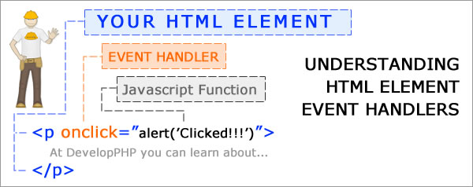
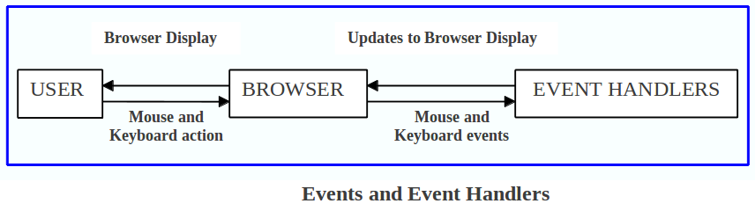
Event Handlers
Live Demo

Slide 12
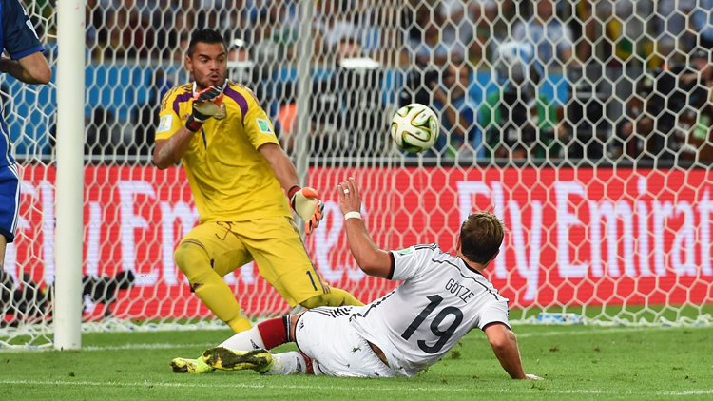
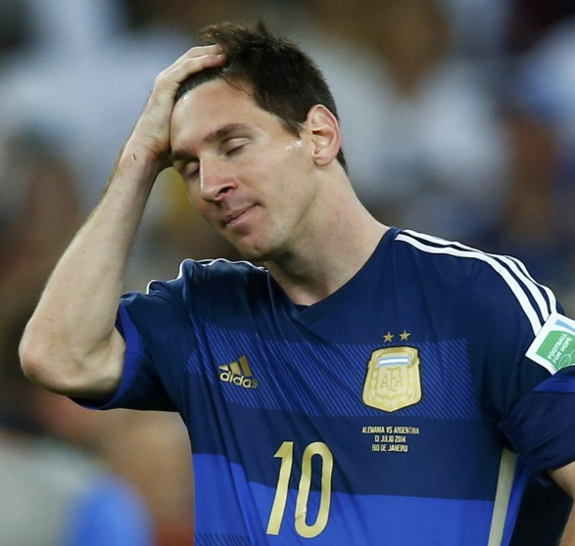
The "event" Object
Just take it

Slide 13
The "event" Object
The "event" object holds information about the event
Passed as parameter to the event handling function
The event object contains information about:
The type of the event (e.g. 'click', 'resize', …)
The target of the event (e.g. the button clicked)
The key pressed for keyboard events
The mouse button / cursor position for mouse events
btn.onclick = function(event) { alert(event); }

Slide 14
Event Object
The "event" object is the only argument of the event handler
Old IE versions pass the event in window.event
function onButtonClick(event) {
console.log(event.target);
console.log(event.type);
console.log("(" + event.clientX + ", " + event.clientY + ")"); }
button.addEventListener("click", onButtonClick, false);
function onButtonClick(event) {
if (!event) event = window.event;
// Your event handling code …
}

Slide 15

The "event" Object
Live Demo

Slide 16
Capturing and Bubbling Events

Slide 17
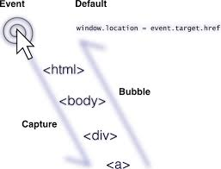
Browser Events Chain
When the user clicks on an HTML element
E.g. on a button in the page
The event is also fired on all of its parents
The button is still the target
But the click event is fired on all of its parents
The click event is fired on all elements in the chain

Slide 18
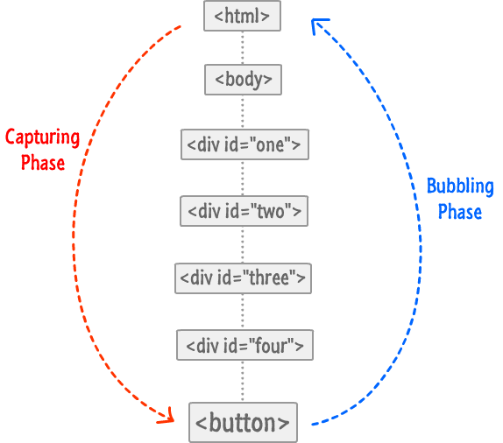
Event Chains: Types
Capturing handlers go down the chain
The first executed handler is on the parent
The last executed handler is on the target
Bubbling handlers bubble up to the parent
The first executed handler is on the target
Then its parent's, and its parent's, etc.
Capturing and Bubbling Explained
domElement.addEventListener(eventType,
eventHandler, isCaptureEvent)

Slide 19

Event Chain
Live Demo

Slide 20
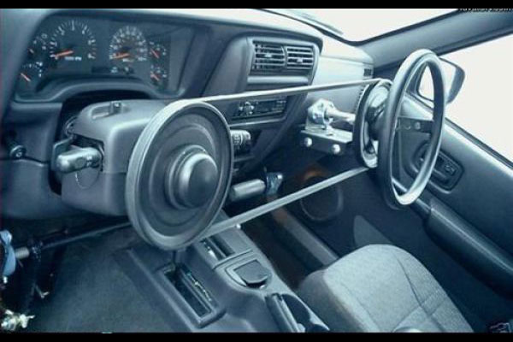
Custom events
Creating and dispatching custom events

Slide 21
Creating custom events
Using the JavaScript API we can create our own events
The CustomEvent class allows you to create your own events.
To create a custom event you need to call the constructor as follows:
new CustomEvent(name, [customEventInit]);
The name of the event
Optional: initialization parameters

Slide 22
Creating custom events(2)
After we create the event we need to add a listener that listens for that event.
Finally we dispatch/trigger the event when needed.
var customEv = new CustomEvent('yell');
elem.addEventListener('yell', function(e) { … });
elem.dispatchEvent(customEv);

Slide 23

Custom events
Live Demo

Slide 24


Summary
JavaScript Event Model
Event Handler Registration
The “event” object
Capturing and bubbling events
Event chaining
Creating custom events
JS Basics

Slide 25









JavaScript DOM and Events
https://softuni.bg/courses/advanced-javascript/

Slide 26
License
This course (slides, examples, demos, videos, homework, etc.) is licensed under the "Creative Commons Attribution-NonCommercial-ShareAlike 4.0 International" license
Attribution: this work may contain portions from
“JavaScript Basics" course by Telerik Academy under CC-BY-NC-SA license

Slide 27





Free Trainings @ Software University
Software University Foundation – softuni.org
Software University – High-Quality Education, Profession and Job for Software Developers
softuni.bg
Software University @ Facebook
facebook.com/SoftwareUniversity
Software University @ YouTube
youtube.com/SoftwareUniversity
Software University Forums – forum.softuni.bg

